Slide 1
Creating a Scanner
Kyle Stanley N. Ty – CMPILER S11
(insert video from test case here)

Slide 2
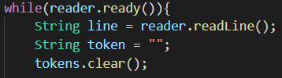

Lexical Analysis
Reading of text input and creating of tokens
BufferedReader to read from input file.
Loop through the input file line by line and create tokens.
Tokens are created by reading left to right until a delimiter is met.
Once the token is created, process that token (in the next slide).

Slide 3
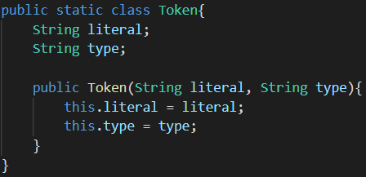
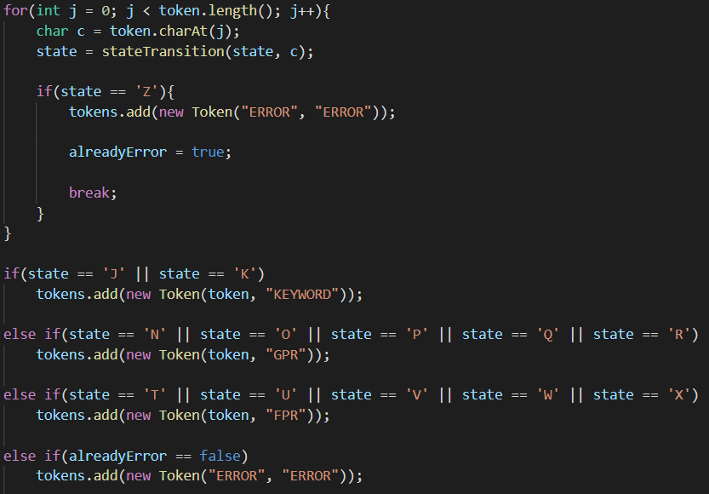
Lexical Analysis
Maximal munch algorithm implementation
Iterate through the whole input/token character by character.
Don’t stop even if a possible final state is reached.
Read until the last character of the token, then from there, determine the last state.
Add the token in the tokens array list together with its token type and string literal.

Slide 4
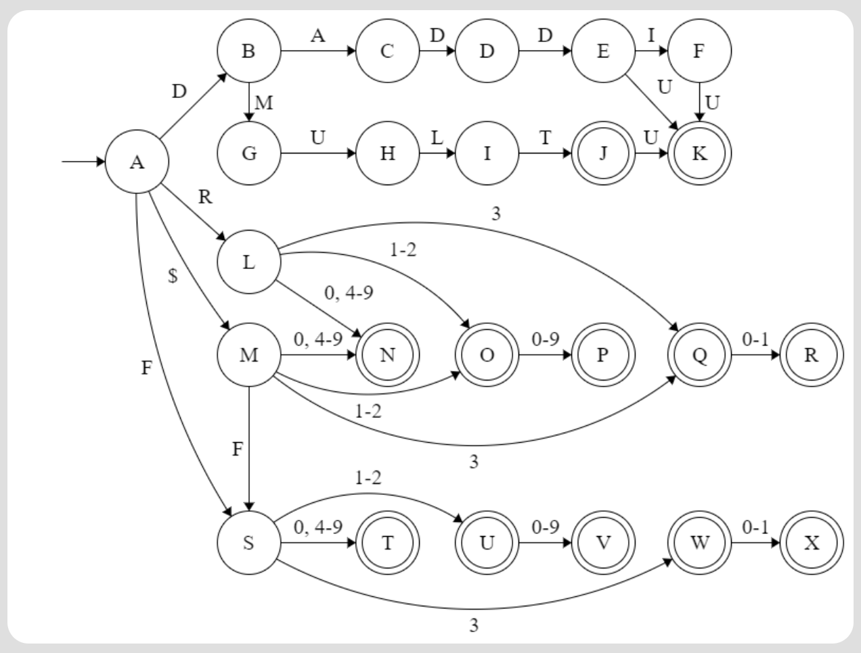
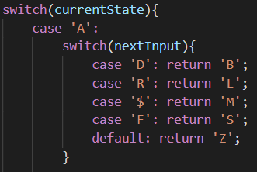
Lexical Analysis
DFA implementation
The DFA was implemented in code and can be seen in the stateTransition function.
A snippet on one of the switch cases.

Slide 5
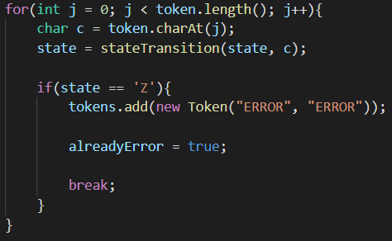

Lexical Analysis
Dealing with unrecognizable tokens
Return state ‘Z’ which is used to represent a dead state in the DFA where the token is unrecognizable and results in an error.
If any of the state reaches state ‘Z’ from the stateTransition function, add a new “ERROR” token into the tokens array list.
Another else statement is present to catch any tokens that do not reach state ‘Z’ but ultimately still do not end up on a valid final state. These tokens are still considered as errors.

Slide 6
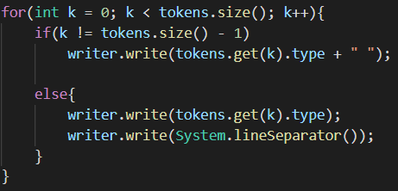
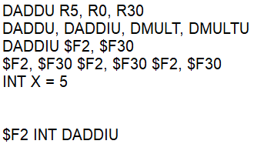
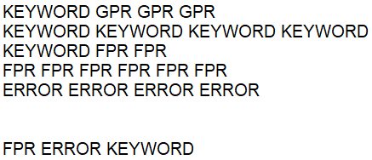
Lexical Analysis
Results and File Output
Use a FileWriter to put the results of token types into an Output file.
Loop through the tokens inside the array list of tokens and write them.
Input.txt
←
Output.txt
→

